Slide 1

Exploring the Boundaries of the Operating System in the Era of Ultra-fast Storage Technologies
R. Madhava Krishnan

Slide 2
Executive Summary
Storage systems are becoming faster, smarter, and memory-centric to keep up with the rising data generation
Operating System (OS) manages the storage hardware and provides an interface for the applications to access the storage
Emerging ultra-fast storage technologies are exposing the performance, programmability, and scalability limitations in the OS storage stack
This thesis proposes novel kernel-bypass designs to overcome the performance, programmability, and scalability limitations in the OS storage stack
This thesis attempts to redefine the traditionally demarcated boundary between the OS and the application to utilize the emerging ultra-fast storage technologies to its fullest potential

Slide 3
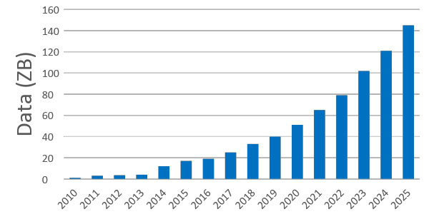
The amount of data we are generating and analyzing is growing exponentially
Annual Size of the Global Datasphere
IDC expects 175 zettabytes of data worldwide by 2025
One person created 1.7MB of data every second in 2020
We are storing 30% to 40% more data every year
Data stored is doubling every 2 to 3 years
More data requires more computation and more storage. The challenge is not limited to storing data but to process and manage it in a faster and cost effective way.
Sources:
Data Age 2025, sponsored by Seagate with data from IDC Global DataSphere, Nov 2018
Source: “Drowning in Data.” IEEE Spectrum, September 2018
How Much Data Is Created Every Day in 2021?
Connected Devices Will Generate 79 Zettabytes of data by 2025
Notes:
We experienced an unprecedented data growth in the last decade
As shown in this figure there is a 30 fold increase in data generated between 2010 and 2020
The future predictions say it is going to get more and more humongous, predicting almost a 150ZB of data in 2025.

Slide 4
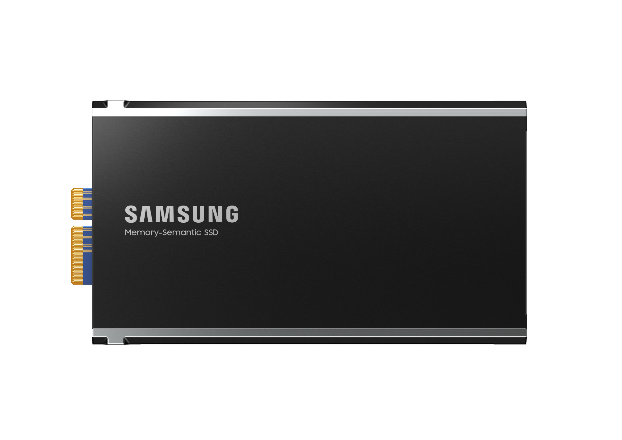
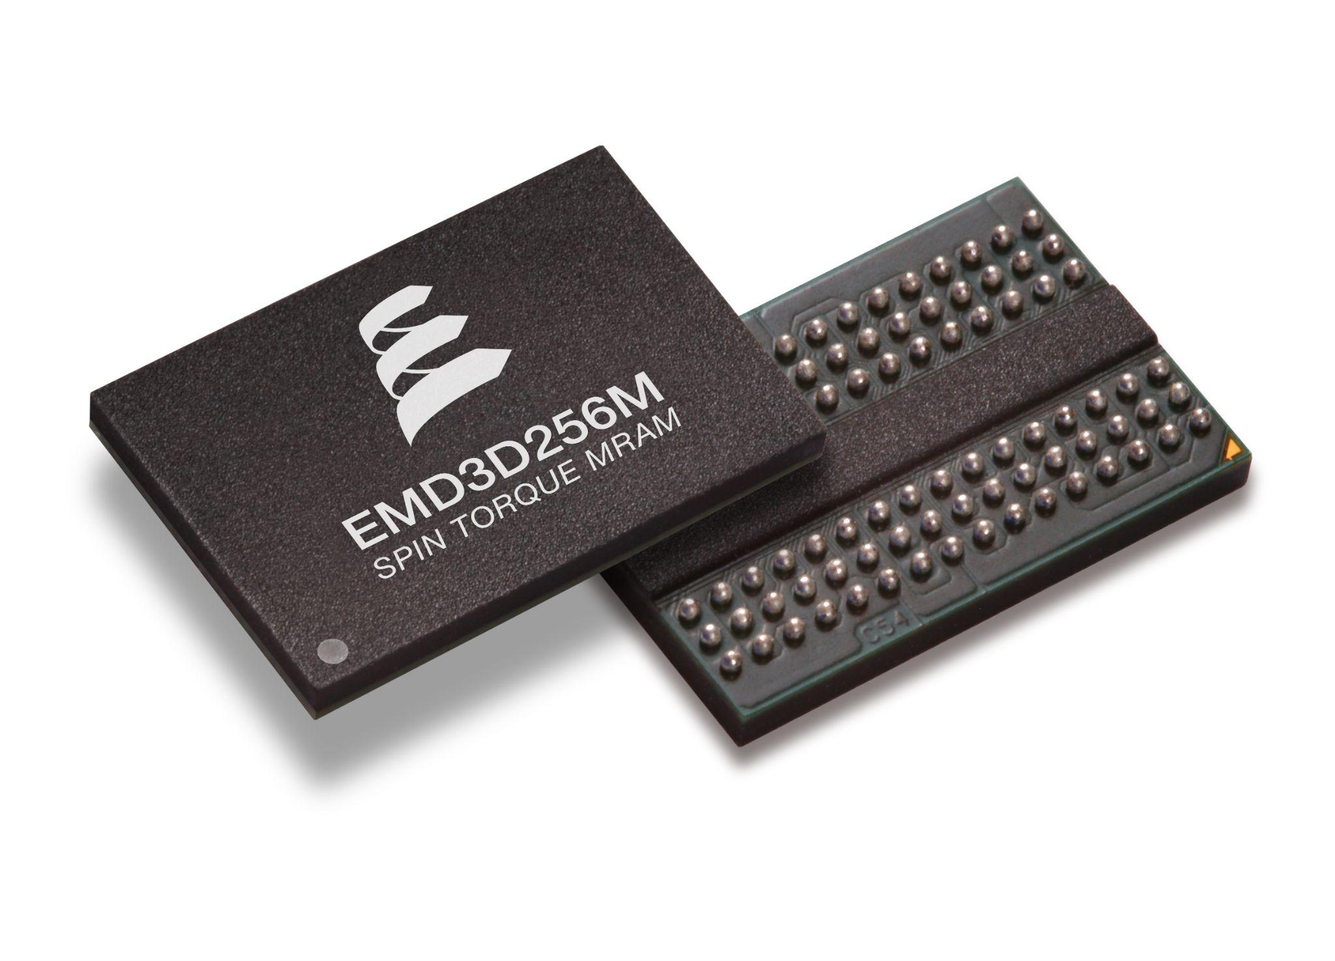
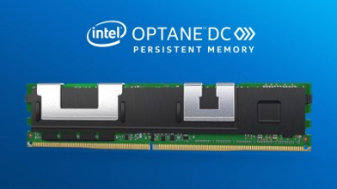
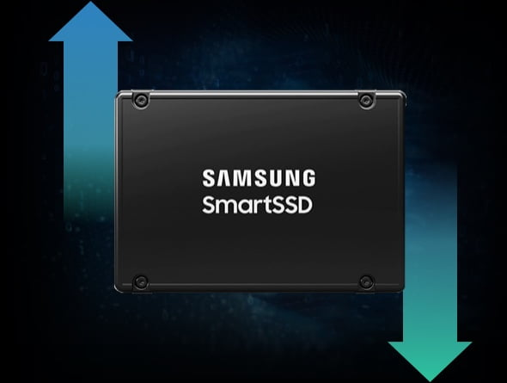
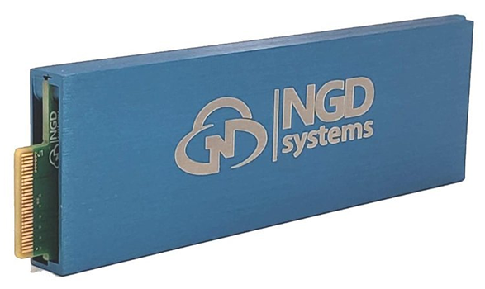
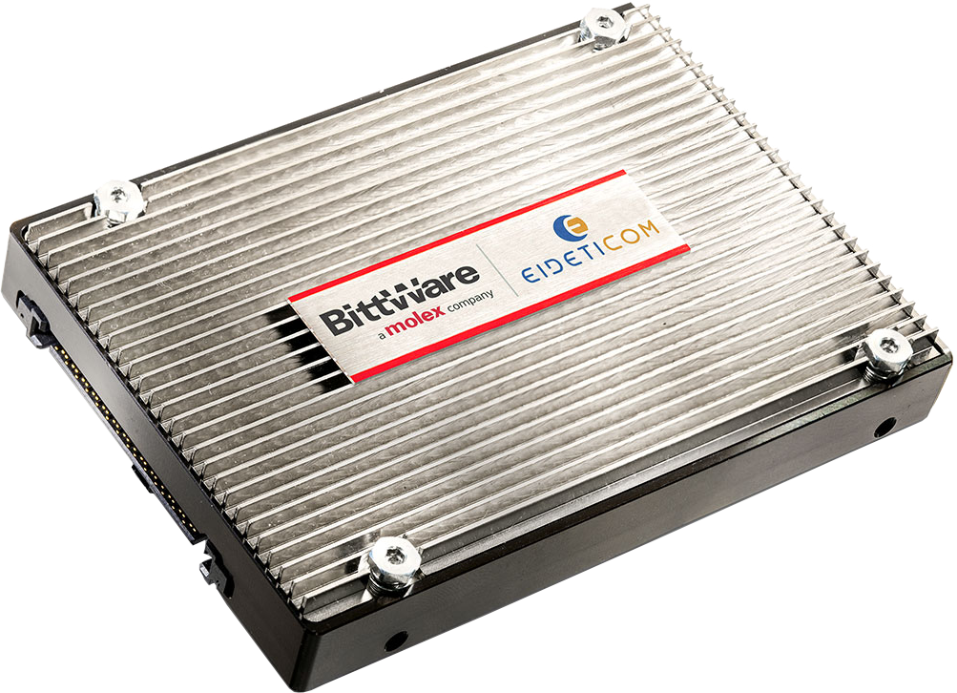
Storage technologies are evolving to keep up with rising data demand
New memory-centric storage technologies are fast -- offer memory like latency and storage like persistence
Some storage technologies are compute capable -- not just store the data but perform compute on the stored data independent of the CPU

Slide 5
Background on memory-centric storage technologies
Byte-addressable like the DRAM
Persistent like the NAND flash
Operates at nanosecond latency, ~100X faster than NAND flash
Lower $/GB than DRAM, ~2x cheaper
We consider Intel’s byte-addressable NVM as a representative memory-centric storage technology

Slide 6
NVM closes the performance gap between memory and storage
CPU
Cache
~10 cycles, latency in ns,
capacity in MB, volatile (e.g., SRAM)
Hot Storage Tier-- Fast Access, Smaller Capacity, High Cost and
Byte-addressable
Offers durability at the main memory latency
~100 cycles, latency in ns,
capacity in GB, volatile (e.g., DRAM)
Main Memory
Closes the performance gap
~400 cycles, latency in ns, capacity in TB, non-volatile (e.g., Intel DCPMM)
Memory-centric storage (e.g., NVM)
High-performance SSDs
~1M cycles, latency in µs, capacity in TB, non-volatile (e.g., Intel Optane SSDs)
Cold Storage Tier--
Slow Access, Large Capacity,
Low Cost and Block-addressable
Hard Disk Drives
~10M cycles, latency in ms,
capacity in TB, non-volatile
(e.g., Segate Internal HDDs)
How can applications leverage the NVM’s byte-addressability and non-volatility feature?
Magnetic disks and Tapes
~100M cycles, latency in sec,
capacity in TB, non-volatile
Storage Capacity
Notes:
Lets begin with asking ourself why NVM is a game changer?
If we take a look at the storage pyramid, we have the blazing fast CPU cache and the main memory at the top.
These devices are non-volatile and come in only with a limited capacity
Then if we go down the pyramid we get in to the cold storage tier which includes SSDs, hard disks and magnetic tapes
These devices are non-volatile and they come in a larger capacity
But the downside is that these devices are too slow
These means that we are left with a large performance gap between main memory and storage.
[click]
This is where NVM comes to the rescue, it is fast and also non-volatile.
[click]
NVM closes the longstanding performance gap between the main memory and the storage

Slide 7





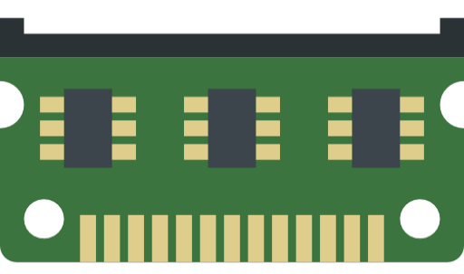
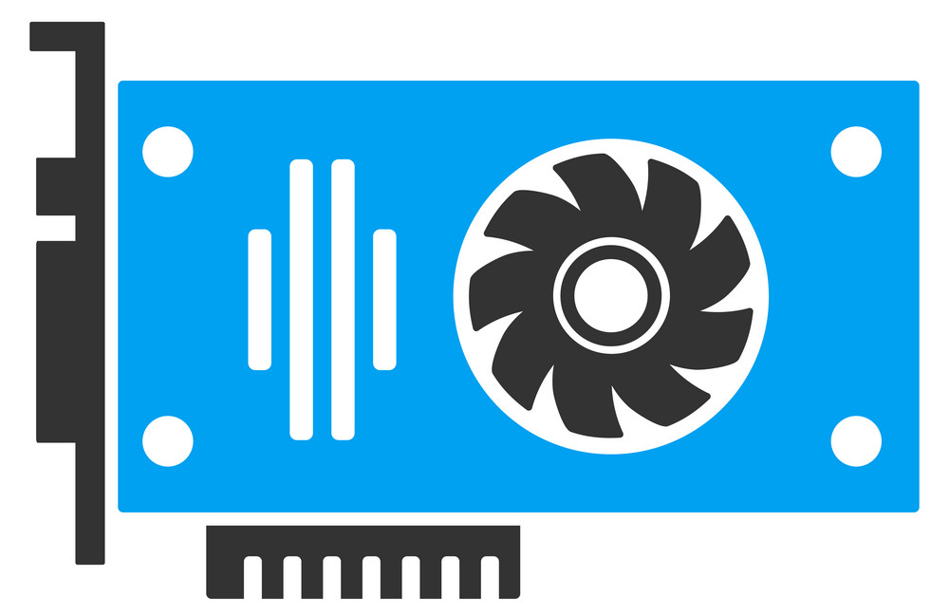
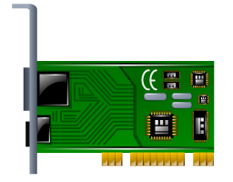

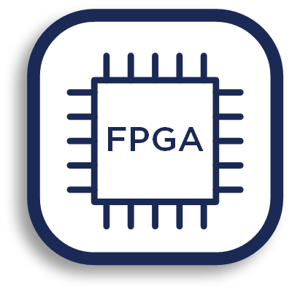
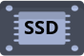
Operating system (OS) manages the storage hardware
OS provides an excellent filesystem based programming abstraction for the applications to effectively read and write to the storage hardware
Applications
Provide interface for OS services
Task scheduler
File system
Operating System (OS)
…
Memory management
OS storage stack becomes a critical bottleneck for the applications using memory-centric storage
Hardware
Notes:
Traditionally, operating system is a hardware resource manager.
<CLICK>
Operating system runs on top of a hardware.
<CLICK>
It manages and multiplexes hardware resources.
<CLICK>
It internally manage an abstraction of a hardware device.
For example, a file system is an abstraction of a physical disk drive.
<CLICK>
With such an abstraction, OS provides a nice interface to applications.
So application can use OS services without worrying about
details of underlying hardware.

Slide 8
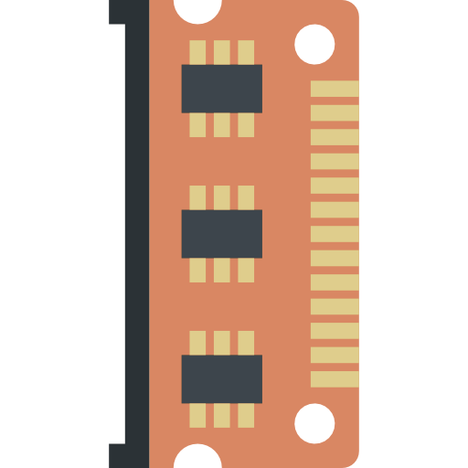
OS storage stack becomes a bottleneck for byte-addressable NVM
Programmability: OS storage stack does not support byte-addressable programming
Application
Filesystem
Call (e.g., write)
Load/Store Instructions
(byte-addressable)
NVM allocator
Block addressable like the traditional storage
NVM filesystem
(e.g., EXT4-DAX)
mmap
region
NVM is mapped to the userspace to enable byte-addressable access
NVM hardware
Applications need to bypass the OS storage stack to exploit the byte-addressability feature -- this complicates the application programming
Notes:
[click]
To use the NVM, a program should use NVM-aware file system, which manages NVM space.
So application can access a file on NVM using read/write system calls.
[click]
However, in this approach, a program should still pay the file system overhead.
[click]
A better approach is to use NVM allocator, such as Intel PMDK.
NVM allocator create a large file on NVM aware file system, which is called an NVM heap.
Then it maps the NVM heap file to user-space application.
[click]
Once the mapping is created, an application can directly access the NVM using load/store instructions.
Direct access to NVM from the application has huge implications in storage stack design.
Now we can design a fast persistent data structures withou having to pay for additional storage overhead in terms of filesystem overhead or context switching overhead
Now that we have a solid understanding on the NVM hardware and software architecture lets see what are the challenges that we have in front of us

Slide 9
OS storage stack bottleneck -- Latency overhead
Performance: OS storage stack increases the NVM access latency
Application
Kernel Crossing -- switching from
userspace address to kernelspace address
15%
62 ns
Applications needs to go through multiple software layers in the OS storage stack to access NVM --
Each layer adds additional latency to access NVM
30%
Syscall Layer
199 ns
Virtual File System (VFS) Layer
55%
++ latency due to kernel crossing
++ syscall overhead
++ filesystem overhead
Actual FS
NVMFS
OS Storage Stack
NVM hardware
Latency Data Source:
An Empirical Guide to the Behavior and Use of Scalable Persistent Memory
XRP: In-Kernel Storage Functions with eBPF

Slide 10
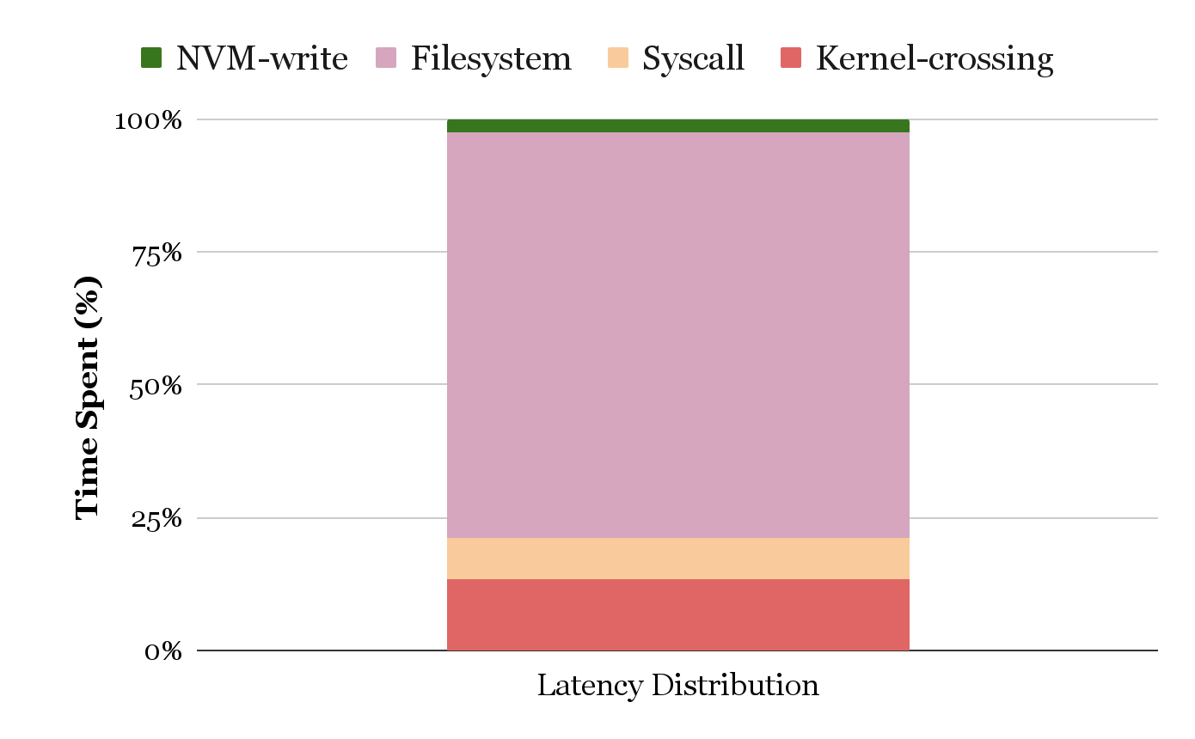
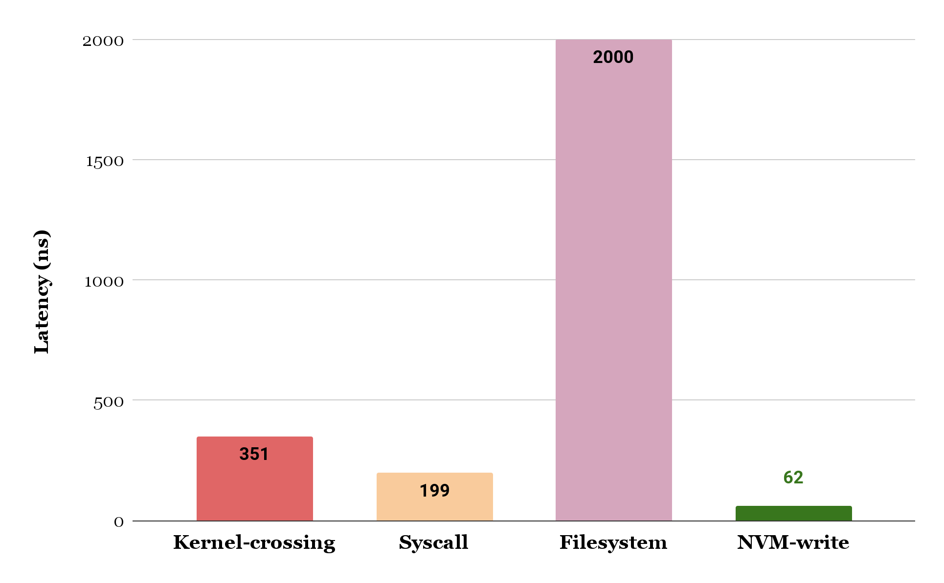
OS storage stack bottleneck -- Context switching overhead
Performance: OS storage stack increases the NVM access latency
Total OS storage stack latency -- 2550ns
Filesystems can be optimized to
reduce the latency
~95%
Raw NVM-write
latency -- 62ns
OS storage stack latency is significantly greater than the NVM media’s write latency -- NVM write latency (62ns) is increased by 9X even with zero filesystem overhead (550ns)
Latency Data Source:
An Empirical Guide to the Behavior and Use of Scalable Persistent Memory
XRP: In-Kernel Storage Functions with eBPF

Slide 11
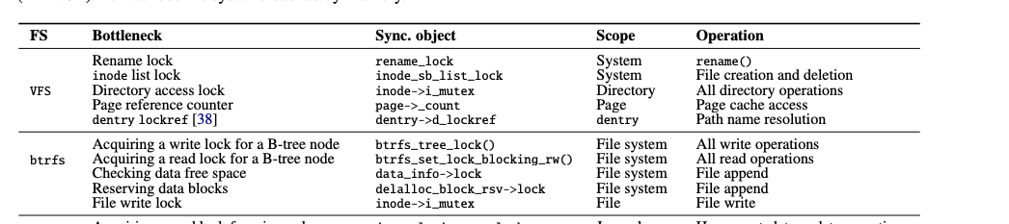
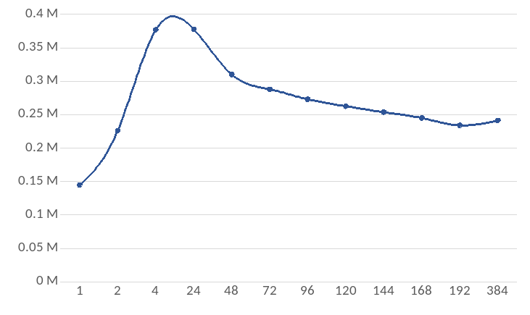

OS storage stack bottleneck -- Scalability bottleneck
Scalability: OS storage stack becomes a scalability bottleneck for applications
Application
Poorly scalable lock based concurrency control
Syscall Layer
Virtual File System (VFS) Layer
Actual FS
Performance (operations/sec)
NVMFS
Simulated mail server workloads with concurrent file operations
OS Storage Stack
NVM hardware
# threads
Understanding manycore scalability of filesystems [ATC-16]

Slide 12
Thesis Overview: Challenges, vision, contributions, and outcomes

Slide 13
Thesis Question and solution
How to explore the memory-centrict storage technologies like the byte-addressable NVM without constrained by the performance, programmability, and scalability limitations of the OS storage stack?
Kernel-Bypass storage stack: Bypass the OS storage stack and implement the storage stack in the userspace
Kernel-bypass storage stack
++ No context switching overhead
++ No syscall overhead
++ Potential to enable byte-addressability by deviating from filesystem abstraction

Slide 14

Kernel-bypass storage stack forgoes isolation
Kernel-bypass storage stack
++ No context switching overhead
++ No syscall and filesystem overhead
++ Enables byte-addressability
-- Forgoes kernel-userspace isolation
-- Memory safety vulnerabilities
-- Needs an efficient programming model
Memory safety bug
e.g., buffer overflow
Unprotected User address range
Applications
Kernel-bypass storage stack
Buggy application can corrupt the kernel-bypass storage stack
OS enforces isolation from buggy applications
Operating System (OS)
Protected Kernel address range

Slide 15



Challenges in designing kernel-bypass storage stack
Applications
Programmability: byte-addressable and crash consistent programming model
Kernel-bypass storage stack
Operating System (OS)
Scalability: Efficient concurrency model to scale performance with increasing core count
Kernel component
Storage hardware
Resilience: Enforce protection against software bugs and hardware errors
Hardware

Slide 16
Thesis vision: Kernel-bypass storage stack architecture
Crash Consistency
Memory Safety
Concurrency
Applications
Memory Management
Recovery
…
Kernel-bypass storage stack
(userspace)
Fast, Scalable, and Resilient storage stack for memory-centric storage
Operating System (OS)
Kernel
Component
…
Task scheduler
Syscall
…
Memory management
Storage
Hardware
: Exploring the Boundaries of Operating System
Hardware
Notes:
As we discussed, now CPU is the bottleneck in storage IO.
So I want to share my recent work on scaling stack stack by avoiding CPU being a bottleneck.
I will leverage emerging storage devices, computational storage and byte-addressable non-volatile memory.
With new hardware, the boundaries and the role between OS, hardware, and userspace library need to be redefined.
So I will discuss the boundaries in this talk.

Slide 17
Thesis contributions: Kernel-bypass techniques for memory-centric storage
ASPLOS-20
Today’s Talk
Timestone: Scalable Persistent Transactional Memory Framework
Fast, Scalable, and Resilient kernel-bypass programming framework
FAST-23
TENET: Memory Safe and Fault Tolerant Persistent Transactional Memory Framework
Application Driven Kernel-bypass Programming Frameworks
ATC-21
TIPS: Porting Legacy KVS and index structures to memory-centric storage
under submission
RETINA: Unified KVS Framework for Scaling Deep Learning Training Using CSD

Slide 18
Thesis outcome: Feature comparison with OS storage stack
Feature | OS storage stack | Kernel-bypass storage stack [TENET]
Programming abstraction | Filesystem | Persistent Transaction
Programming support | No, only block-adderssable | Yes, byte and block-addressable
Multi-core scalability | Poorly scalable | Scales across 100’s CPU cores
Latency scale | Micro-second scale | Nano-second scale
Isolation and Safety | Yes | Yes, also fault tolerant
Why transactional programming abstraction?
How to make transactional programming scalable and high-performant?
How to make transactional programming memory safe and fault tolerant?

Slide 19
Durable Transactional Memory Can Scale With Timestone
In the Proceedings of the 25th ACM International Conference on Architectural Support for Programming Languages and Operating Systems (ASPLOS 2020)
Notes:
First i will presenting my first research work titled durable transactional memory can scale with timestone
This work has been published in the last year’s ASPLOS conference

Slide 20
Transactional programming model for byte-addressable NVM
Why transactional programming model?
Transactions support byte-addressable access
Concurrent programming is easy with transactional model
Software Transactional Memory (STM) designed for concurrent DRAM programming
Persistent Transactional Memory (PTM) extends STM to support crash consistent updates to storage
Applications using PTM do not need to worry about concurrency and crash consistency
Applications have to define a serial single-threaded code region and the transaction library guarantees concurrent and crash consistent execution

Slide 21
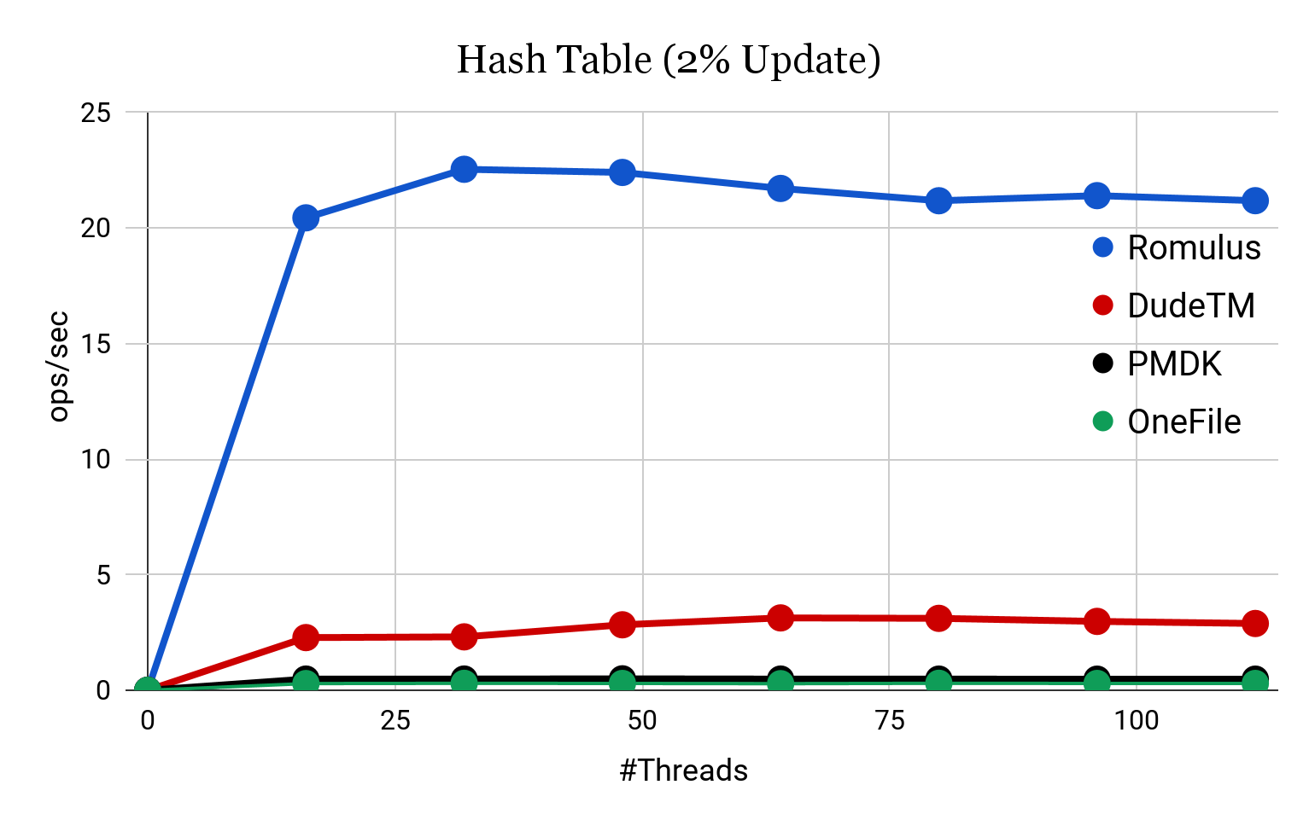
Prior PTMs suffer from high overhead and poor scalability
Performance saturates
Poorly scalable concurrency control
DudeTM → tinySTM, Global locking table
PMDK → Readers-writer lock
Romulus → single writer combining
High Write Amplification (WA) due to crash consistency operations
16
DudeTM → REDO logging, 4X WA
PMDK → REDO and UNDO logging, 70X WA
Romulus → Data mirror, 2X WA
None of the DTMs scale beyond 16 core counts
DudeTM: Building Durable Transactions with Decoupling for Persistent Memory [ASPLOS -17]
Romulus: Efficient Algorithms for Persistent Transactional Memory [SPAA-18]
PMDK: Persistent Memory Development Kit [Intel]
OneFile: Onefile: A wait-free persistent transactional memory [DSN-19]
Notes:
This figure shows the performance of the existing DTMs for a hash table benchmark with 2% update
[click]
To our surprise none of the existing DTMs scales beyond 16 cores
So we begin to uncover the reasons for the poor scalability and we found two possible causes

Slide 22
Transactional programming model can scale with Timestone
How to make transactional programming scalable and high-performant?
Timestone: Multi-version Concurrency Control (MVCC) based Persistent Transactional Memory (PTM)
Adopt MVCC for multi-core scalability by supporting non-blocking reads and disjoint writes
TOC Logging for high-performance and efficient crash consistency by reducing write amplification
Notes:
this idea of transactions were adopted for designing concurrent in-memory data structures In the late 2000’s
It was called software transactional memory and it was sought as alternative to lock-based syncronization
One important point to note is that STMs do not consider the durability property in their design as they target the volatile DRAM
[click]
But unfortunately it never garnered much attraction mainly due its inability to scale

Slide 23

MVCC supports concurrent non-blocking reads
Reader (R)
Readers can proceed while on-going write
Both the readers can proceed
Writer (W)
Node A
Node B
Node C
Version
Chain
Node A
Out-of-place Updates
1
Readers are always guaranteed to see a consistent version of an object and hence there is no read-write conflict
Notes:
Lets take an example of updating a linked list node
[click]
Suppose a writer wants to update Node A
It first makes a copy of Node A
[click]
Then performs the modifications on the copy
[click]
And adds the updated copy to the version chain, note that each linked list node will create its own version chain when they are updated
[click]
The good thing here is that the ongoing-write is hidden from the other readers and writers.
This means that there is always a consistent copy of NODE A available in the memory
even if a reader wants to read node A while its being updated, it can be allowed.
[click]
In the same time lets say there are two concurrent readers on Node B, there are allowed to proceed as well.
[click]
Lastly, lets suppose there are two writers trying to update Node C, in this scenario only one of the writers will succeed.
[click]
The other writer will abort and retry
[click]
This is how MVCC supports concurrent non-blocking reads and disjoint writes

Slide 24
MVCC supports concurrent disjoint writes
Reader (R)
Writer (W)
Node A
Node B
Node C
Version
Chain
Node A
Node C
1
1
Non-conflicting writers can perform concurrent execution
Notes:
Lets take an example of updating a linked list node
[click]
Suppose a writer wants to update Node A
It first makes a copy of Node A
[click]
Then performs the modifications on the copy
[click]
And adds the updated copy to the version chain, note that each linked list node will create its own version chain when they are updated
[click]
The good thing here is that the ongoing-write is hidden from the other readers and writers.
This means that there is always a consistent copy of NODE A available in the memory
even if a reader wants to read node A while its being updated, it can be allowed.
[click]
In the same time lets say there are two concurrent readers on Node B, there are allowed to proceed as well.
[click]
Lastly, lets suppose there are two writers trying to update Node C, in this scenario only one of the writers will succeed.
[click]
The other writer will abort and retry
[click]
This is how MVCC supports concurrent non-blocking reads and disjoint writes

Slide 25

MVCC supports concurrent disjoint writes
Reader (R)
Writer (W)
Node A
Node B
Node C
Version
Chain
Node A
Node C
1
1
conflicting writers are serialized for correctness
Notes:
Lets take an example of updating a linked list node
[click]
Suppose a writer wants to update Node A
It first makes a copy of Node A
[click]
Then performs the modifications on the copy
[click]
And adds the updated copy to the version chain, note that each linked list node will create its own version chain when they are updated
[click]
The good thing here is that the ongoing-write is hidden from the other readers and writers.
This means that there is always a consistent copy of NODE A available in the memory
even if a reader wants to read node A while its being updated, it can be allowed.
[click]
In the same time lets say there are two concurrent readers on Node B, there are allowed to proceed as well.
[click]
Lastly, lets suppose there are two writers trying to update Node C, in this scenario only one of the writers will succeed.
[click]
The other writer will abort and retry
[click]
This is how MVCC supports concurrent non-blocking reads and disjoint writes

Slide 26
TOC Logging for efficient crash consistency
Traditional journaling techniques like UNDO and REDO logging causes high write amplification
MVCC also causes high write amplification as it creates new version on every write operation
TOC Logging: multi-layered hybrid NVM-DRAM logging technique to reduce write amplification due to logging and MVCC

Slide 27
TOC Logging hybrid NVM-DRAM architecture
TOC logging is a multilayered hybrid DRAM-NVM logging
Transient Version log on DRAM (TLog)
New version during write operation is created on the TLog
To leverage faster DRAM and enable batching writes to NVM
Operational log on NVM (OLog)
Log only the operation semantics (“what app did”) rather than logging the entire data
To Guarantee immediate durability in the critical path
Checkpoint log on NVM (CLog)
Periodical snapshot of TLog is checkpointed on the CLog
To guarantee correct recovery and fast recovery time
Notes:
To achieve a low write amplification Timestone proposes a multilayered hybrid DRAM-NVM logging scheme called the TOC logging
TOC logging includes three different logs namely
Transient version log or the Tlog placed in the DRAM
Operational log or the Olog placed in the NVM
And lastly the checkpoint log or the CLog placed in the NVM as well
In the next slide I will illustrate how these three logs works in tandem to reduce the write amplification in timestone

Slide 28
TOC Logging in Action
Update_node (A , V₃)
Immediate Durability with low Overhead
DRAM
NVM
Node A
V
9
update_node
(A, V₁)
update_node
(A, V₂)
update_node
(A, V₃)
Operational Log (Olog)
Writeback
Transient Version Log (Tlog)
Node A
V₁
Node A
V₂
Node A
V₃
Node A
V₃
Node A
V₅
Node A
V₇
Node A
V₉
Writes Coalesced
Checkpoints Coalesced
Checkpoint
Log (Clog)
Checkpointing
Only the latest updates are written to NVM
Further reduces the amount of NVM writes
Notes:
Let us consider a linked list nodeA and a writer wanting to update it
[CLICK]
The writer makes an out-of-place update in its private Transient Version log
[CLICK]
After the update, the writer logs the transaction semantics in its Operational log and at this point the transaction becomes durable. The good part about operational logging is that we just log the operation semantics rather than logging the entire memory region that is being updated.
This is significant in reducing the logging overhead in the write critical path
[CLICK]
when TLOG becomes full checkpointing is triggered
[CLICK]
Note that the writer checkpoints only the latest update, ignoring all the previous updates to node A
[CLICK]
So this write coalescing is key to achieve a lower write amplification
[CLICK]
Let's say as the time progress there are some more checkpoints are being made in the checkpoint log
[CLICK]
In order to free up some space in the Checkpoint log the writer triggers the writeback operation
And again we write back only the latest checkpoint ignoring all the previous checkpoints of the Node A
This log coalescing becomes more significant in case of a larger data structure especially when the workload is write-intensive or skewed

Slide 29
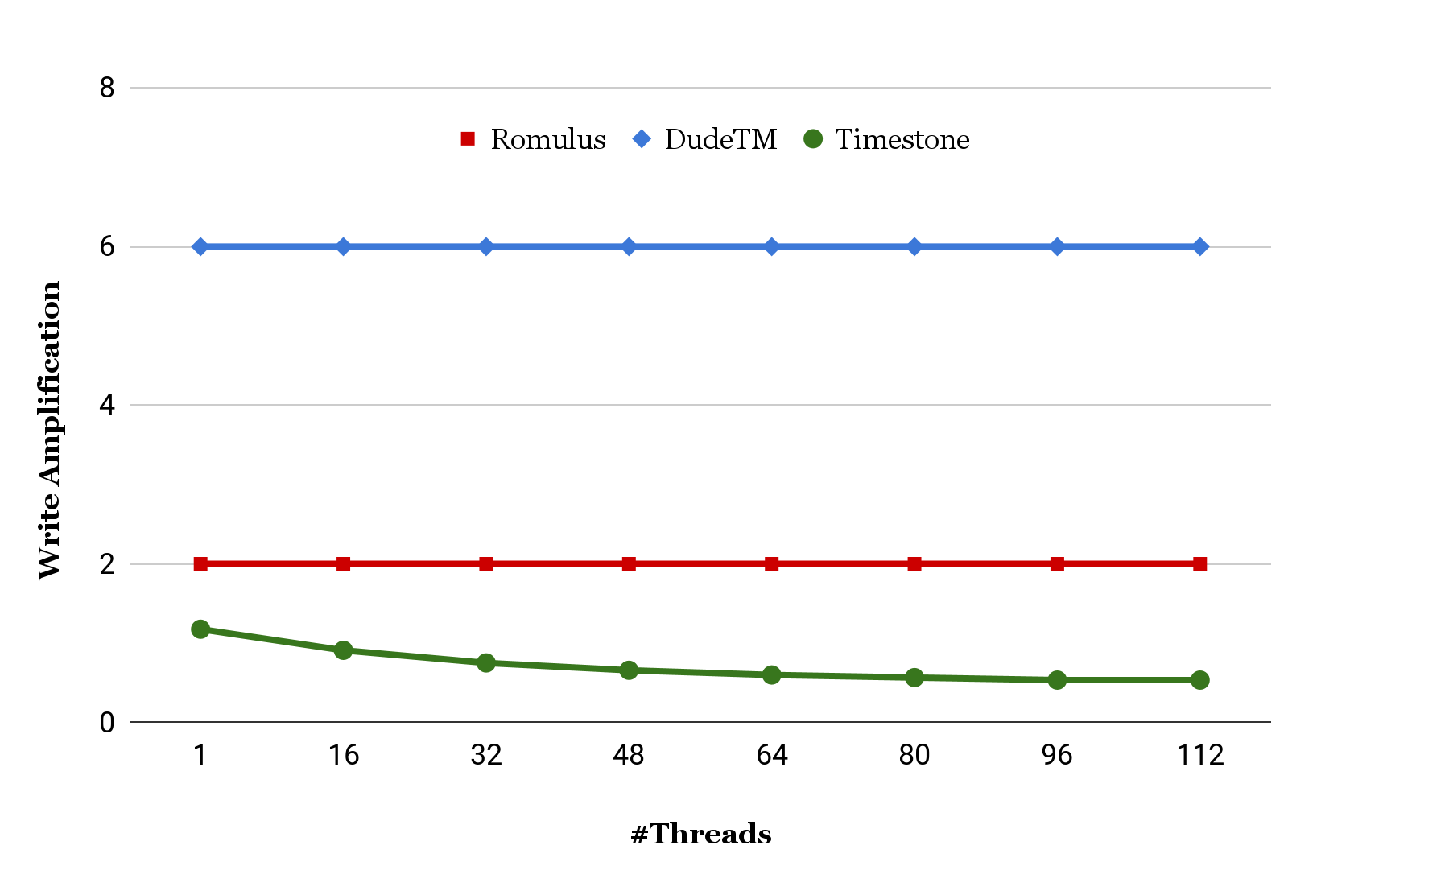
Write amplification for hash table (80% Update)
Write Amplification of Timestone is always <= 1
Notes:
In this figure, we show the write amplification of different DTM systems for a write intensive hash table benchmark
Vertical axis is the write amplification and the horizontal axis represents the number of concurrent threads in the system
[CLICK]
As shown, timestone always maintains write amplification <=1 while other DTMs such as DudeTM incurs a write amplification of up to 6X and Romulus upto 2X consistently.

Slide 30
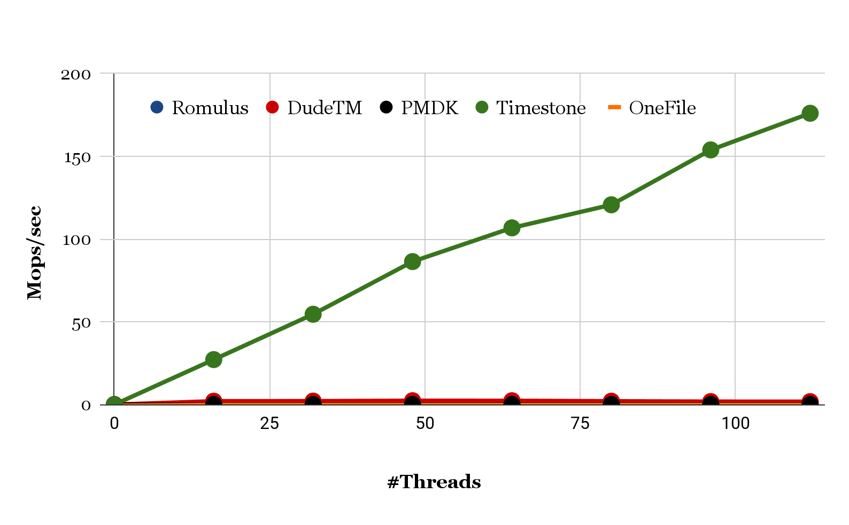
Scalability for write-intensive hash table (80% Update)
Timestone still scales linearly
Timestone performs 100x faster than DudeTM
Notes:
This figure shows the scalability of Timestone for write intensive workload
The vertical axis represents the throughput in ops/usec and teh horizontal axis represents the number of concurrent threads in the system
[CLICK]
Timestone scales linearly and it performs upto 100x better than DudeTm which is the next best performing DTM system.
To summarize,
[click]
Timestone supports better RW parallelism than the existing DTMs and hence it shows a superior scalability
The low write amplification in Timestone makes the critical path shorter which eventually leads to better performance and high scalability

Slide 31
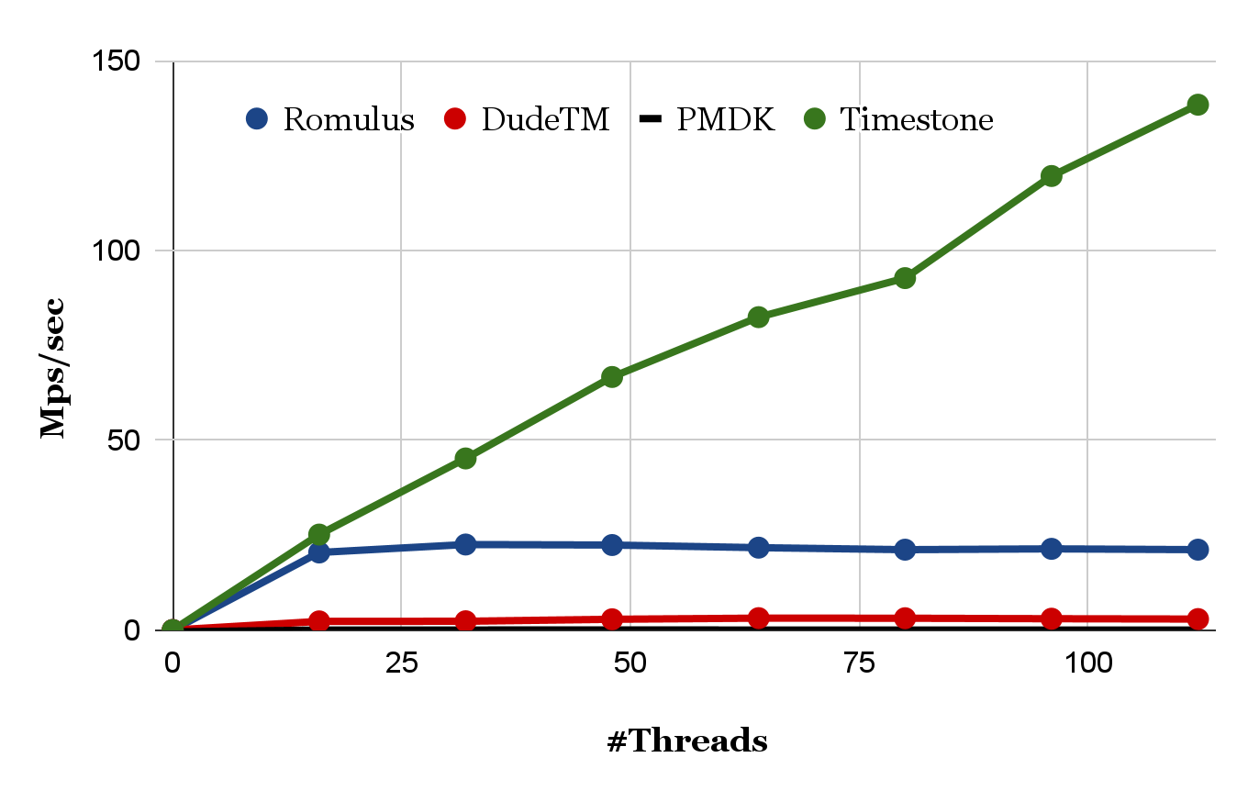
Scalability for read-intensive hash table (2% Update)
Timestone still scales linearly
Timestone performs 6.5x faster than Romulus
Notes:
This figure shows the scalability of Timestone for write intensive workload
The vertical axis represents the throughput in ops/usec and teh horizontal axis represents the number of concurrent threads in the system
[CLICK]
Timestone scales linearly and it performs upto 100x better than DudeTm which is the next best performing DTM system.
To summarize,
[click]
Timestone supports better RW parallelism than the existing DTMs and hence it shows a superior scalability
The low write amplification in Timestone makes the critical path shorter which eventually leads to better performance and high scalability

Slide 32
Summary of Timestone’s features
Timestone PTM
++ Scalable for 100’s of CPU cores
++ High performance for different data structures and workloads
-- Vulnerable to software bugs and media errors
Application
How do we protect the Timestone PTM and the NVM data from software bugs and media errors?
Timestone PTM
TENET: guarantees memory safety from software bugs and fault tolerance against media errors
NVM Media
NVM media error

Slide 33
TENET: Memory Safe and Fault Tolerant PTM
In the Proceedings of the 21st Conference on File Systems and Storage Technologies
(FAST 2023)
Notes:
First i will presenting my first research work titled durable transactional memory can scale with timestone
This work has been published in the last year’s ASPLOS conference

Slide 34
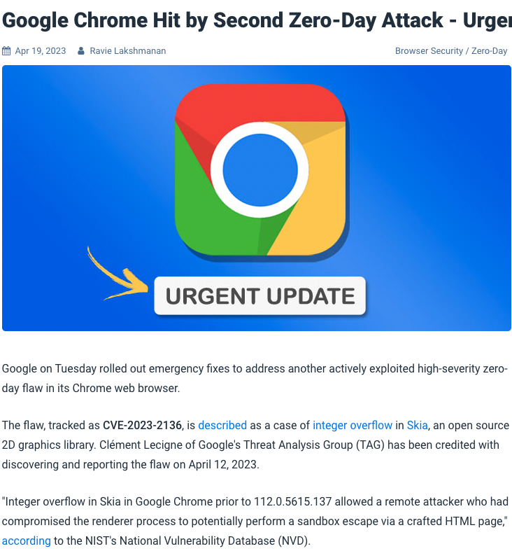
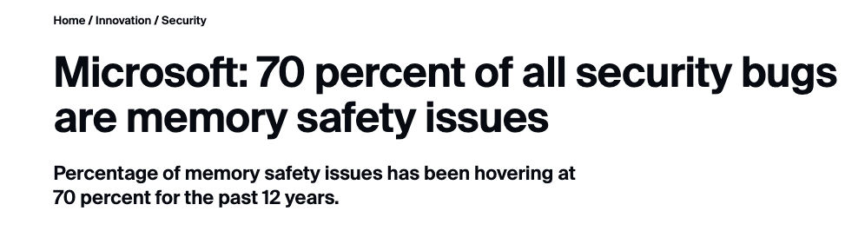
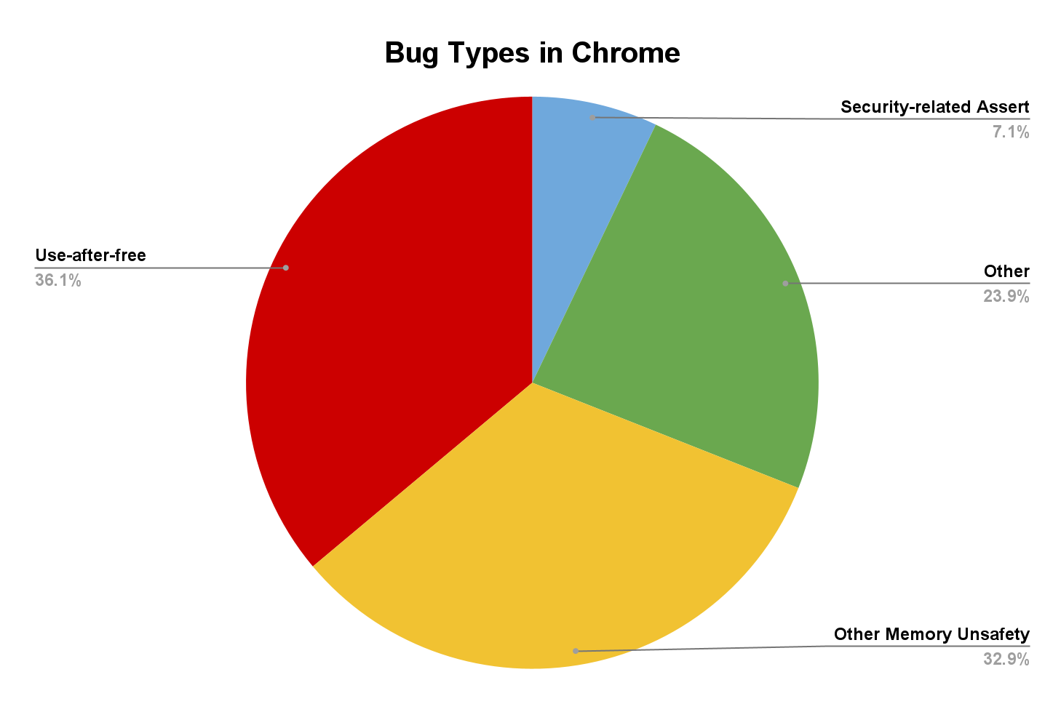
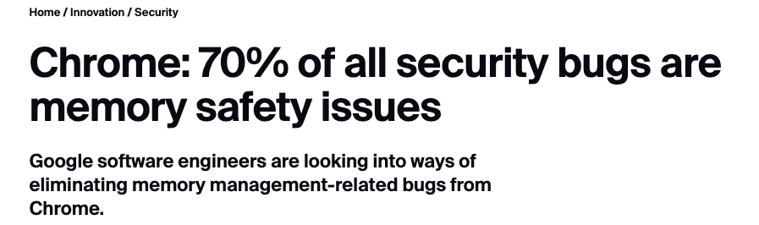
Memory safety bugs are common and a critical issue!
https://www.chromium.org/Home/chromium-security/memory-safety/
https://www.zdnet.com/article/microsoft-70-percent-of-all-security-bugs-are-memory-safety-issues/

Slide 35

Background on types of memory safety violations
01
Memory Safety Violations
Spatial Safety Violations
Temporal Safety Violations
Spatial Safety Violations
Temporal Safety Violations
(1) Alloc
(2) Free
(3) Realloc
memcpy(buff, src, 64)
buff
buff
buff
buff (32 bytes)
use-after-free
use-after-realloc
buffer overflow
Ptr = buff
Spatial safety violations happens when applications access the memory beyond the allocated range
Temporal safety violations happens when applications access the memory using dangling pointers

Slide 36


Prior memory safety works suffer from high performance and cost overhead
PTM | Baseline PTM* | Spatial Safety | Temporal Safety | Fault Tolerance | Performance Overhead | NVM Cost Overhead
Libpmemobj-R | libpmemobj |  |  |  | 100% | High
SafePM [Eurosys-22] | libpmemobj |  |  |  | 55%
Pangolin [ATC-19] | libpmemobj |  |  |  | 67% | Moderate
Guaranteeing memory safety and fault tolerance at a lower performance overhead and cost is a very challenging problem
*Performance overhead reported for hash table
*Pangolin’s overhead is directly referenced from the paper

Slide 37

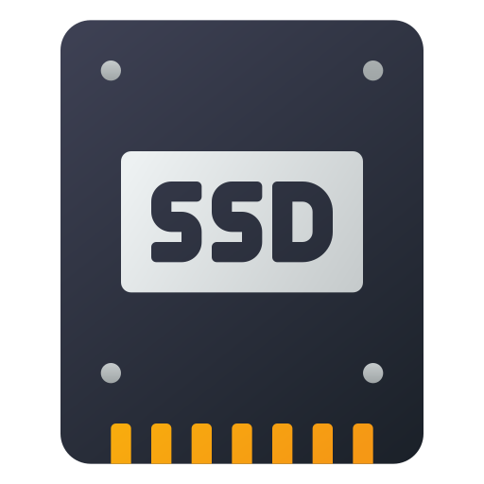
TENET overview: Goals and Assumptions
TENET is an NVM programming framework to develop memory safe and fault tolerant NVM data structures and applications
Protect NVM data from a buggy application code
Guarantee spatial safety and temporal safety
Protect NVM data against Uncorrectable Media Errors (UME)
Guarantee a performance and cost efficient fault tolerance
TENET adopts Timestone PTM as its programming model and adds memory safety and fault tolerance support

Slide 38
Spatial safety design in TENET
Application code or any code outside the TENET library is not allowed to perform direct NVM writes
Only the TENET library code is allowed to perform writes to the NVM data

Slide 39
Direct NVM writes in the application code is dangerous
A buggy application write on the NVM can cause spatial safety violation
Application code:
memcpy(buffer, src, 128)
Readers access the
corrupted data
NVM Pool
Buffer (64 bytes)
Node A
Node B
Node C
NVM objects (application data structure)
NVM is read-only for the application to prevent buggy writes from corrupting the NVM data

Slide 40


Prevent direct NVM writes using Memory Protection Keys (MPK)
TENET uses MPK to enforce read-only access to the NVM object pool for all the code outside of the TENET library
Application code:
write(Node B)
Readers do not need to validate NVM objects
MPK domain
SIGSEGV Exception
…
Node A
Node B
Node C
…
NVM objects
NVM Object Pool (read-only access)
How does application write to the NVM objects?

Slide 41
Prevent direct NVM writes using Memory Protection Keys (MPK)
Applications write only on the DRAM region and TENET writes back the DRAM object to the NVM after validating it for spatial safety
DRAM Objects
Updates to NVM object pool
through the TENET library
Application code:
Update (B,B²)
Validate DRAM Object for spatial safety violation
Node B
Node B²
How does TENET validate the DRAM objects?
…
Node B²
Node A
Node B
Node C
…
NVM objects
NVM Object Pool (read-only access)

Slide 42


Protecting DRAM objects using canary bits
TENET assigns 8 byte canaries at the boundary of a DRAM object and the canary bits are inspected when the application commits the transaction
Corrupted canary bits indicates a spatial safety violation
Buggy Application
write
DRAM Objects
MPK and Canary bits validation together guarantees spatial safety for the NVM data
…
Canary(C0)
Node A²
Canary(C1)
Canary(C0)
Node B²
Canary(C1)
…
Spatial safety violation bug
Commit time canary bits validation
Abort and terminate the program

Slide 43
Read-only NVM access can cause temporal safety violations
Applications can dereference a dangling pointer to an NVM object as TENET grants read access to the NVM
Does making NVM read-only solve all the problems and prevent NVM data corruption?
Application code:
deref(NodeB)
NVM object dereference succeeds
Temporal safety violation
use-after-free bug
NVM Object Pool (read-only access)
…
Node A
Node B
Node C
…
Node B is already freed
NVM objects
How does TENET enforce temporal memory safety for the NVM objects?

Slide 44
Enforcing temporal safety for NVM objects using pointer tags
NVM address is tagged at the time of creation; the tag is stored in the allocated NVM object and a copy of the tag is encoded in the upper 16 bits of the NVM pointer
The encoded pointer to Node B is stored in Node A
Node A
tag = 0xFACE
Encoded pointer
Node B
tag = 0xCAFE
tag is stored in the NVM object at the time of creation
Upper 16 bits are unused
Node B’s address → 0x00001265FFCAB734; Tag → 0xCAFE
Encoded pointer → Node B || Tag << 48 → 0xCAFE1265FFCAB734
tag bits
NVM address
Encoded pointer layout
63 48 0
A copy of the tag is encoded to the upper 16 bits of Node B’s address
tag 0xCAFE
Address

Slide 45

Enforcing temporal safety for NVM objects using pointer tags
Application accesses the NVM objects using the encoded pointer -- the encoded tag in the pointer is compared with the tag stored in the corresponding NVM object
Application code:
deref(NodeA-->next)
Node A
tag = 0xFACE
Encoded pointer
Node B
tag = 0xCAFE
Application dereferences the encoded pointer
Encoded Node B pointer [NodeA→next]
tag 0xCAFE
Address
Compare tags ==
Valid NVM pointer dereference

Slide 46
Enforcing temporal safety for NVM objects using pointer tags
Dangling pointer is detected by comparing the tag stored in the NVM object with the tag encoded in the pointer to the NVM object
Application code:
deref(NodeB)
Node A
tag = 0xFACE
Encoded pointer
Node B
tag = NULL
Node B is freed
Node B’s address
tag 0xCAFE
Address
Compare tags ==
Dangling pointer dereference
use-after-free bug

Slide 47
Memory safety techniques are performance efficient
MPK and pointer tags do not incur any additional crash consistency overhead
MPK is a userspace hardware primitive -- < 20 cycles to switch permissions
++ Performance
Pointer tags are embedded in the address -- no centralized metadata management
++ Scalability
Every NVM load and store do not need to be checked for memory safety violations
Spatial safety checks of DRAM objects only at the commit time -- new objects are not visible before transaction commits
++ Performance
Temporal safety checks of NVM objects only at first dereference -- a derefrenced object cannot be freed by a concurrent write transaction
++ performance

Slide 48
Replicating NVM data for fault tolerance against UME
NVM data corruption due to software errors
Spatial memory safety → MPK + canary bits validation
Temporal memory safety → Pointer tags validation
How does TENET make the NVM data fault tolerance against the UME?
TENET replicates the NVM data to the local SSD to maintain backup copy
Restore the corrupted NVM page from the SSD replica
TENET’s replication provides many desirable properties
Cost efficiency → replicating to the local SSD
Performance efficiency → replicating the data out-of-the critical path
Consistent loss-less recovery

Slide 49
Evaluation of TENET
How does TENET compare against the prior PTM works in terms of features and performance overhead?
Evaluation Settings
We use a 2 socket server with 64 core Intel Xeon Gold CPU
64GB DRAM, 512GB NVM, 1TB SSD
We evaluate two different versions of TENET
TENET-MS → supports only memory safety
TENET → supports memory safety and fault tolerance
We evaluate TENET with different data structures for different read/write ratios
YCSB workloads and microbenchmarks

Slide 50
Comparison of TENET with the other PTMs
PTM | Baseline PTM* | Spatial safety | Temporal Safety | Fault tolerance
Libpmemobj-R | libpmemobj
SafePM [Eurosys-22] | libpmemobj
Pangolin [ATC-19] | libpmemobj
TENET | Timestone
Replicates NVM data to a local NVM pool -- High cost overhead
Uses address sanitizer (Asan) -- High performance overhead
Supports parity based replication and object checksums -- High performance overhead due to increased write amplification
TENET is the only PTM to provide spatial memory safety, temporal memory safety, and fault tolerance for the NVM data
*PTM - persistent transactional memory
*Libpmemobj is a transactional library in the PMDK

Slide 51
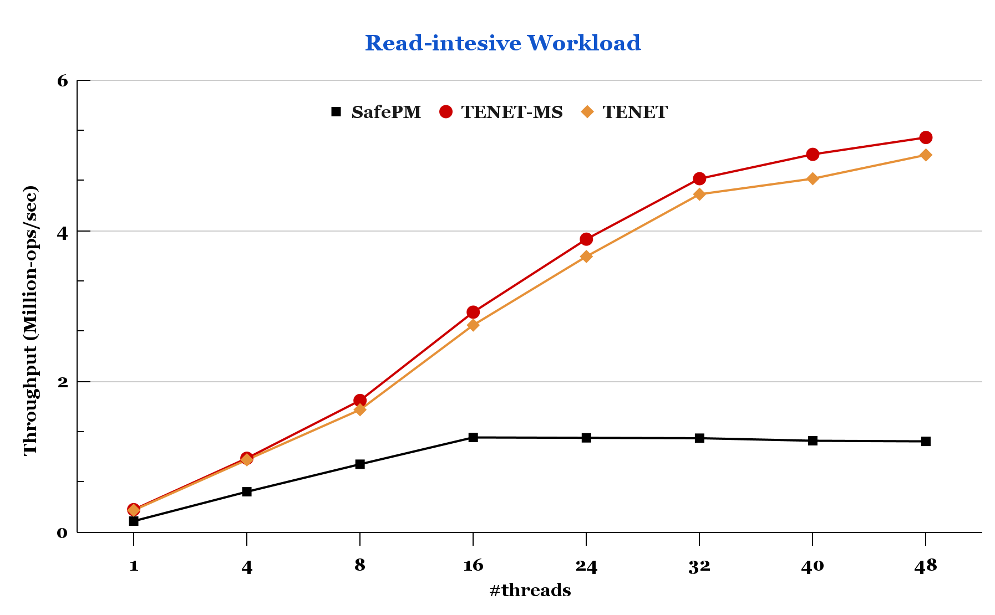
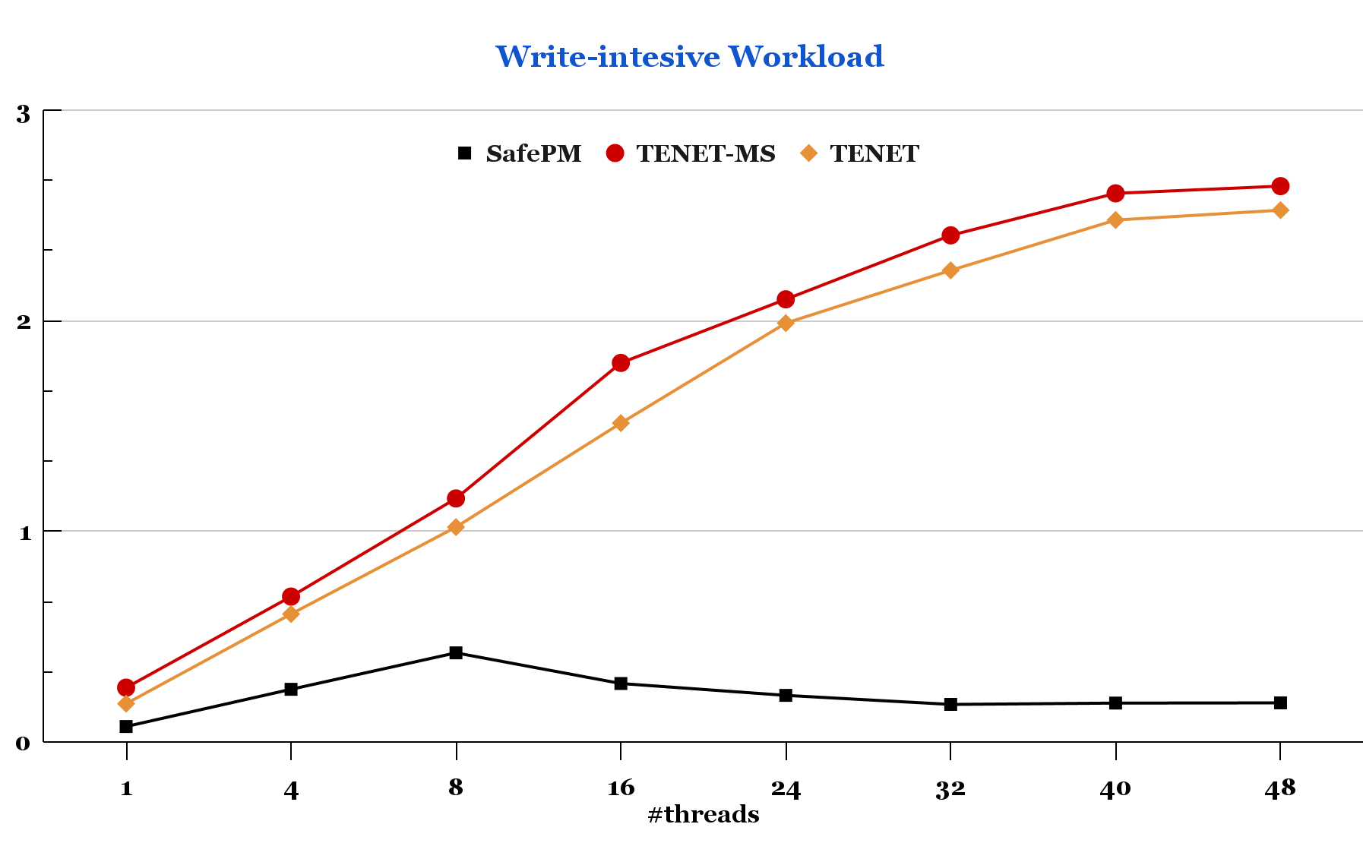
Performance of TENET and SafePM for hash table
Memory safety only
Memory safety only
~8%
~3.5X
~13X
Memory safety +
fault tolerance
Memory safety + fault tolerance
TENET is up to 13x faster than SafePM
Adding replication incurs only a 8% performance overhead
TENET does not compromise the scalability of the Timestone PTM

Slide 52
Other Thesis Contributions

Slide 53
TIPS: Framework for porting legacy KVS to NVM
What if an application does not need transactional interface? Or How can we enable legacy KVS applications to work on NVM?
TIPS: provides a black-box framework for legacy volatile DRAM based KVS and index structures to run on NVM by transparently making them crash consistent and recoverable
Space efficient generic caching technique designed for high performance
UNO logging for efficient crash consistency and consistent no-loss recovery
Tiered concurrency model with adaptive scaling for multi-core scalability and durable linearizability

Slide 54
TIPS: high level idea and contributions
Application can access Redis KVS via the TIPS framework using the facade APIs
The plug-in process is agnostic i.e., same two steps for any application data structure and concurrency control
Application
Replace memory allocation to NVM
malloc() → tips_alloc()
Instrument all store operations with tips_undo_add API for crash consistency
TIPS Framework
Redis KVS
TIPS guarantees durable linearizability for all its conversions, the gold standard correctness condition
Application can plug-in Redis or any other KVS using plug-in APIs provided by TIPS

Slide 55
TIPS: Evaluation results
Indexes | Concurrency Control | LoC
Hash Table | Readers-Writer Lock | 5/211
Lock-Free Hash Table | Non-blocking reads and writes | 5/199
Binary Search Tree | Readers-Writer Lock | 5/203
Lock-Free Binary Search Tree | Non-blocking reads and writes | 5/194
B+Tree | Readers-Writer Lock | 8/711
Adaptive Radix Tree | Non-blocking reads and blocking writes | 9/1.5k
Cache-Line Extensible Hash Table | Non-blocking reads and blocking writes | 8/2.8k
Redis Key-value Store | Blocking reads and writes | 18/10k
Converted 8 applications with different with different concurrency control techniques, less than 20 LoC changes for all the conversions
TIPS enabled indexes supports critical features and performs, scales on-par or better than indexes that are particularly optimized for NVM

Slide 56
RETINA: KVS framework for scaling DL training using CSD
Computational Storage Drive (CSD)
NVMe SSD
P2P
FPGA
Memory
P2P
FPGA
Near-storage accelerator performs compute on the SSD data without moving the data back and forth to the CPU memory
CSD- Computational storage drives
DL - Deep Learning

Slide 57
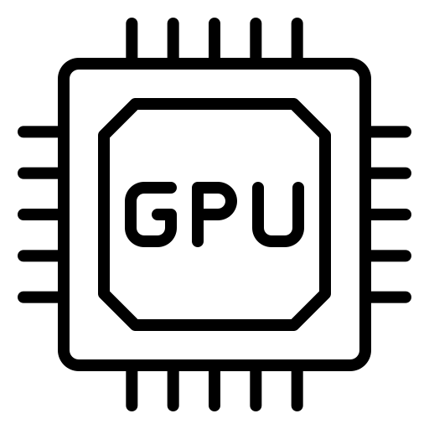
RETINA: KVS framework for scaling DL training using CSD
Can we leverage CSD to solve the storage side data movement bottleneck and CPU side preprocessing bottleneck in the Deep Learning (DL) training?
Traditional DL preprocessing pipeline
SSD
CPU Cores
GPU cluster
CPU
random
resize
color
augment
crop &
mirror
224*224
raw image
1024 * 1024
Image Preprocessing
Image Training
Data movement bottleneck -- moving large images via PCIe bus
CPU bottleneck -- preprocessing on slow CPUs increases GPU idle time

Slide 58
RETINA: KVS framework for scaling DL training using CSD
DL preprocessing pipeline in RETINA
Computational Storage
GPU cluster
raw image
1024 * 1024
random
resize
color
augment
crop &
mirror
224*224
Image Training
Preprocessing is done on the SSD using the near-storage accelerator
Reduces CPU utilization -- host CPUs are free from performing preprocessing
Reduces the data movement -- Only the smaller preprocessed images are moved via the PCIe bus
Reduces GPU idle time -- faster preprocessing and reducing data movement improves the GPU utilization

Slide 59
RETINA: KVS framework for scaling DL training using CSD
RETINA exposes the preprocessing offload to storage using KVS framework
KVS to index data on the SSD -- lookup, scan, insert, delete operations
Unified preprocessing pipeline on the near-storage FPGA -- perform preloaded preprocessing functions
Integrated RETINA to the Tensorflow and performed ResNet50 DL model training
CPU utilization reduced by 97% and GPU utilization improved by 25% as compared to the traditional pipeline model
36% faster preprocessing on the near-storage FPGA than preprocessing images on the cpu in the traditional pipeline model

Slide 60
Other Research Works
Many-core scalable synchronization primitive for DRAM
MV-RLU scales up to 440 CPU cores
MV-RLU: Scaling Read-Log-Update with Multi-Versioning
Jaeho Kim, Ajit Mathew, Sanidhya Kashyap, R. Madhava Krishnan, and Changwoo Min (ASPLOS 2019)
POSEIDON: Safe, Fast and Scalable Persistent Memory Allocator Anthony Demeri, Wook-Hee Kim, R. Madhava Krishnan, Jaeho Kim, Mohannad Ismail, and Changwoo Min (Middleware 2020)
PACTree: A High Performance Persistent Range Index Using PAC Guidelines Wook-Hee Kim, R.Madhava Krishnan, Xinwei Fu, Sanidhya Kashyap, and Changwoo Min (SOSP 2021)
Scalability and Memory Safety from the NVM allocator POV
Uncovers the safety vulnerabilities in the PMDK allocator
Design principles for NVM software design
Tackles scalability across NUMA, concurrency and crash consistency
Notes:
[click]

Slide 61
Talk Summary: Solution contributions
Feature | OS storage stack | Kernel-bypass storage stack [TENET]
Programming abstraction | Filesystem | Persistent Transaction
Programming support | No, only block-adderssable | Yes, byte and block-addressable
Multi-core scalability | Poorly scalable | Scales across 100’s CPU cores
Latency scale | Micro-second scale | Nano-second scale
Isolation and Safety | Yes | Yes, also fault tolerant
Why transactional programming abstraction?
Makes programming easy
Hides concurrency and crash consistency
How to make transactional programming scalable and high-performant?
MVCC for Scalability
TOC Logging for high performance
How to make transactional programming memory safe and fault tolerant?
MPK and Canary bits for spatial memory safety; pointer tags for temporal memory safety
Asynchronous NVM-SSD replication for performance and cost-efficient fault tolerance

Slide 62
Talk Summary: Achieving the research vision
Programmability: byte-addressable and crash consistent programming
Scalability: Efficient concurrency model to scale performance
Resilience: Enforce protection against software bugs and hardware errors
TENET PTM
Scalable programming model
Fast, scalable, and Resilient kernel-bypass storage stack
TIPS: KVS programming framework
RETINA: KVS for scaling DL pipeline
Timestone PTM
Thank You
Questions?
Notes:
My research works focuses on designing system softwares for NVM focusing mainly on the scalability, performance and safety aspects
[click]
My first research work timestone, tackles the scalability problem. To achieve scalability it adopts multi-version concurrency control and also proposes a novel hybrid logging technique called TOC logging which is paramount in reducing the write amplification
[click]
My other research work TIPS, focuses on creating an ecosystem of mature NVM indexes by converting the existing volatile index structures and key-vlue stores to work efficiently on the NVM
Overall TIPS framework makes the conversion simple yet effective in terms of applicability, performance and safety

Slide 63
Backup

Slide 64
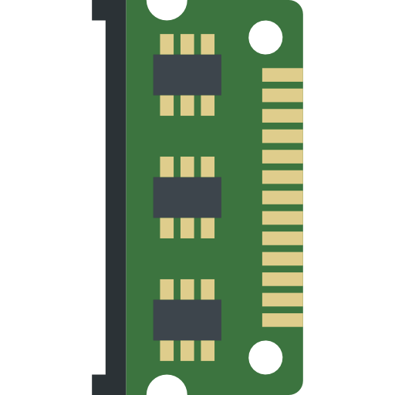
A closer look at the byte-addressable NVM
CPU Core
CPU Core
Non-volatile domain in eADR systems
L1/L2 $
L1/L2 $
Volatile domain i.e., data
can not survive a crash
Last Level Cache (LLC)
Mesh Interconnect
NVM
Integrated Memory Controller
Integrated Memory Controller
WPQ
DRAM
Persistence domain i.e., data can survives crash
How can applications leverage the NVM’s byte-addressability feature?
WPQ: Write Pending Queue
Notes:
This figure shows the architecture of Intel optane NVM which is the only commercially available NVM at the moment
As shown, NVM sits on the CPU bus righ alongside the DRAM
[click]
The cpu cache including the last level cache belongs to the volatile domain
[click]
the Non-volatile domain begins from the memory controller, this means if the data reaches the NVM memory controller it is guarantee to be persisted.
This means that if any data that is left in the volatile domain would not survive crash and during recovery those updates in the CPU cache will be lost

Slide 65
Talk Summary: Achieving the research vision
Programmability: byte-addressable and crash consistent programming
Scalability: Efficient concurrency model to scale performance
Resilience: Enforce protection against software bugs and hardware errors
TENET PTM
Scalable programming model
Fast, scalable, and Resilient kernel-bypass storage stack
Timestone PTM
Thank You
Questions?
Notes:
My research works focuses on designing system softwares for NVM focusing mainly on the scalability, performance and safety aspects
[click]
My first research work timestone, tackles the scalability problem. To achieve scalability it adopts multi-version concurrency control and also proposes a novel hybrid logging technique called TOC logging which is paramount in reducing the write amplification
[click]
My other research work TIPS, focuses on creating an ecosystem of mature NVM indexes by converting the existing volatile index structures and key-vlue stores to work efficiently on the NVM
Overall TIPS framework makes the conversion simple yet effective in terms of applicability, performance and safety

Slide 66
Future works
Rethinking the techniques in the context of CXL enabled storage stack -- byte-addressable programming, scalability, and memory safety problems are highly relevant
Concurrent programming framework for CXL enabled cache coherent accelerators -- extending Timestone PTM to support transactional programming across accelerators and CPUs
Extending RETINA to support programming other CSD architectures -- programming computational storage array would enable RETINA to scale distributed DL training

Slide 67
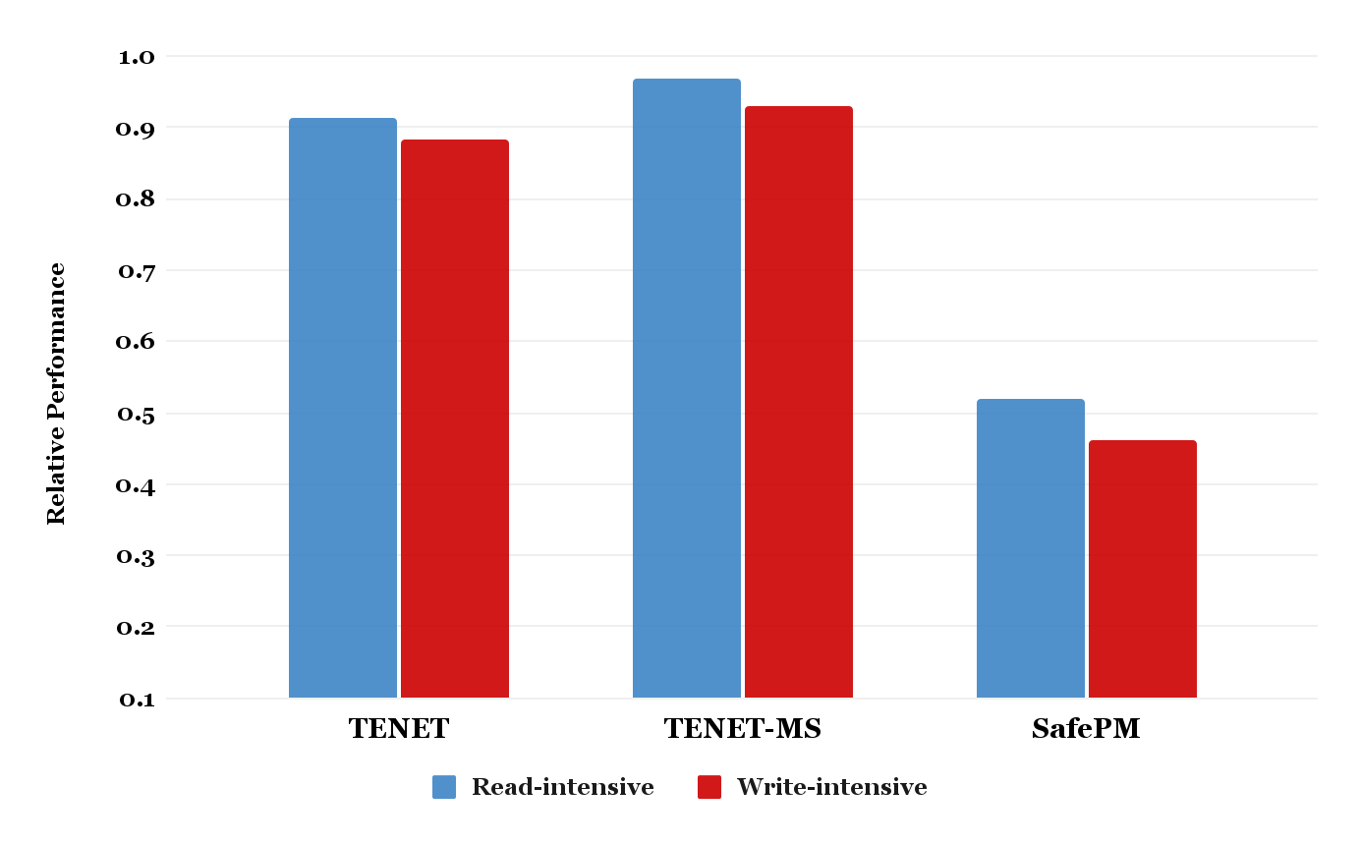
Performance of TENET and SafePM for hash table
~12% slower
than Timestone
~4% slower
than Timestone
~55% slower
than libpmemobj
1.0 → is the maximum possible performance
SafePM incurs ~55% performance overhead for only memory safety guarantee
Higher the better
Checks every NVM loads and stores -- high performance overhead
Centralized memory safety metadata -- high crash consistency overhead
TENET adds ~12% performance overhead for memory safety and fault tolerance
Performance is normalized to their respective baseline PTMs
SafePM normalized to the libpmemobj → throughput (safePM)/throughput (libpmemobj)
TENET normalized to the TimeStone → throughput (TENET)/throughput (Timestone)

Slide 68
Background on types of Media Errors
02
NVM Media Errors
Correctable Media Errors
Uncorrectable Media Errors
NVM has high Random Bit Error Rate (RBER) ~= NAND flash
Uncorrectable media errors (UME) are detected by the hardware ECC but can not be corrected
UME can happen at random offset and the OS kernel offlines the corrupted NVM page
Application is responsible for fixing the corrupted NVM page
Applications are required to maintain a backup of NVM data to rollback the affected NVM page to prevent data loss

Slide 69
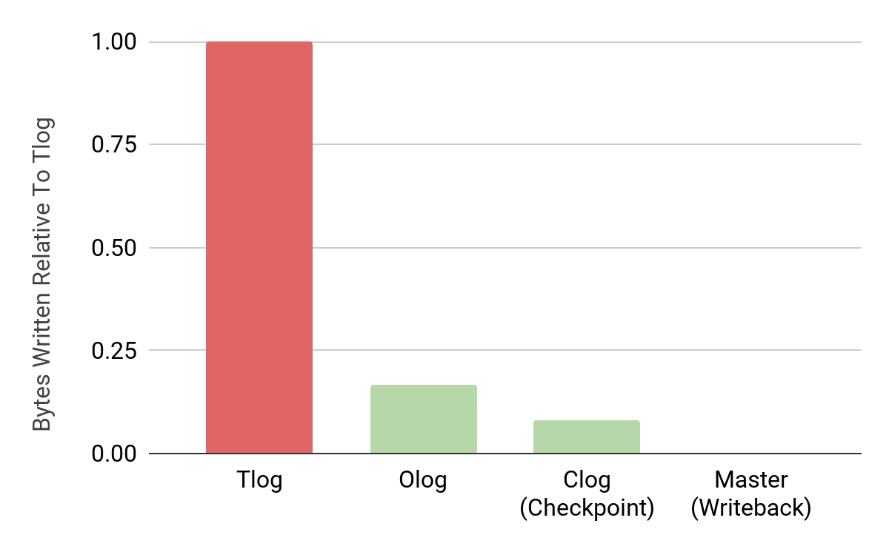
Write Coalescing in TOC Logging
100%
DRAM Writes
Only 7% of writes are checkpointed from Tlog
The rest are coalesced in the Tlog
NVM Writes
Only 0.01% of writes are written back to master
The rest are coalesced in the Tlog and Clog
16%
0.01%
7%
Notes:
To further support our low write amplification claim, let us take look at the amount of writes in each of logs in Timestone
Vertical axis represents the number of bytes written relative to the Tlog
[CLICK]
If we see closely only 7% of writes are being checkpointed to the CLOG from the TLOG, the rest being coalesced in the TLOG itself.
[CLICK]
Similarly only a fraction of TLOG writes are eventually written back to the master object meaning that a huge amount of writes are being coalesced in the TLOG and CLOG.
SO this eventually shows why write amplification in Timestone is consistently less than 1 when compared to the other systems

Slide 70
Performance of TENET and SafePM for hash table
~11% slower
than Timestone
~4% slower
than Timestone
~55% slower
than libpmemobj
TENET does not require additional crash consistency operations for its memory safety metadata
MPK → hardware primitive
Pointer tags → embedded directly into the object
Higher the better
TENET does not perform memory safety validation for every NVM access
Spatial safety checks performed only at the commit time
Temporal safety checks performed only at the first-dereference of an NVM object
Performance is normalized to their respective baseline PTMs
SafePM normalized to the libpmemobj
TENET normalized to the TimeStone

Slide 71
Replicating NVM data for fault tolerance
NVM Log Pool Replication
NVM Object Pool Replication
Primary Log Pool
OLog
CLog
Primary Object Pool
Update (B,B³)
Update (A,A²)
Update (B,B⁴)
…
Node A¹
Node B¹
Node B²
…
…
Node A
Node B
Node C
…
Synchronous Replication
Asynchronous Replication
Replica Object Pool
Update (B,B³)
Update (A,A²)
Update (B,B⁴)
…
Node A¹
Node B¹
Node B²
…
…
Node A
Node B
Node C
…
Replica Log Pool
OLog
CLog
The logs are synchronously replicated on the NVM in the critical path
The NVM objects are asynchronously replicated on the SSD out of the critical path

